Slide 1
Sales and Profit Trends Dashboard
Interactive Power BI Dashboard Based on sales_data_sample.csv

Slide 2
Objective
Objective of This Dashboard
To design an interactive dashboard for business stakeholders to:
Monitor Sales, Orders, and Growth %
Understand monthly sales trends
Identify top-performing product lines and products
Analyze country/region performance
Support data-driven decision-making

Slide 3
Dataset & Methodology
Dataset Overview
Source: Kaggle –sales_and_profit_trends.csv Contains:Row ID,Order ID , Order Date, Ship Date , Ship Mode , Customer ID , Customer Name , Segment , Country/Region , City ,State , Postal Code, Region , Product ID ,Category ,Sub-Category ,Product Name, Sales Quantity, Discount Profit .
Total rows: ~1199
Key Columns: ORDERNUMBER, PRODUCTNAME, PRODUCTLINE, SALES, QUANTITYORDERED, ORDERDATE, COUNTRY

Slide 4
Dataset & Methodology
Methodology:
Cleaned missing values
Converted ORDERDATE to Date type
Created new measures using DAX:
Total Sales
Total Orders
Total Quantity
Growth %
Average Order Value
Designed KPIs + charts
Added slicers for interactivity

Slide 5
KPIs Used
Key Performance Indicators
Total Sales – overall revenue
Total Orders – number of orders completed
Average Order Value – sales ÷ number of orders
Sales Growth % – month-over-month % growth
Total Quantity Sold – units ordered

Slide 6
Methodology
Loaded dataset into Power BI
Checked and converted data types (OrderDate → Date)
Created DAX measures:
Total Sales
Total Orders
Average Order Value
Sales Growth %
Total Quantity Sold
Designed KPIs, line & bar charts
Added slicers for interactivity

Slide 7
KPI Summary
ey Performance Indicators Used
1. Total Sales: Shows total revenue generated
2. Total Orders: Number of customer orders
3. Average Order Value: Average purchase size
4. Sales Growth %: Month-over-month sales change
5. Total Quantity: Total units sold
Why These KPIs?
They give a clear snapshot of business performance and help identify sales movement, demand, and growth.

Slide 8
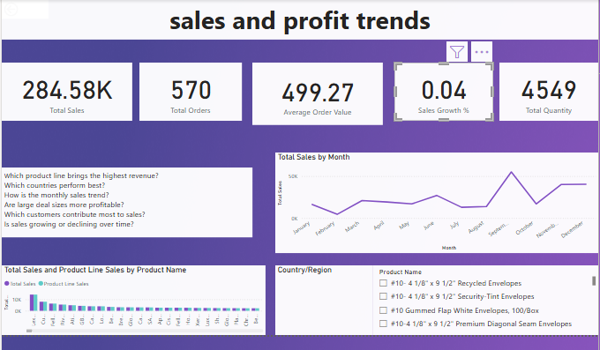
DASHBOARD

Slide 9
Dashboard Layout
Dashboard Preview
(Insert your dashboard screenshot here — the image you shared)
Your layout includes:
KPI Cards at the top
Monthly Sales Trend line chart
Product-wise and Product Line-wise sales chart
Region/Country performance section
Business questions panel

Slide 10
Interactivity
Interactive Features in the Dashboard
Stakeholders can:
Filter by Product Name, Region, Country, Month, etc.
Use slicers to explore trends
Hover for details in tooltips
Compare performance across categories
Zoom into specific months or products
This helps in better exploration and decision-making.

Slide 11
Key Insights
Insights from the Sales & Profit Trends Dashboard
Monthly sales show fluctuations with peaks in August and November
Certain product lines generate significantly higher sales
Some products consistently underperform
Growth % is positive but low (0.04%)
Quantity sold varies widely across product categories
Specific countries drive more revenue (based on data)

Slide 12
Recommendations
Business Recommendations
Focus marketing on high-performing product lines
Improve promotions for slow-moving products
Increase stock during peak months
Analyze underperforming regions to improve strategy
Track growth regularly and set target benchmarks

Slide 13
Conclusion
Summary & Next Steps
Dashboard highlights sales patterns, product performance, and growth trends
Enables fast decision-making using key metrics and visual insights
Next steps: automate refresh, integrate more datasets, publish to Power BI Service

